Slide 1


SPRING VALLEY VILLAGE POLICE DEPARTMENT
MONTHLY NEWSLETTER:
APRIL 2025
1025 CAMPBELL ROAD
HOUSTON, TX 77055
PHONE: 713-465-8323
COMMUNITY MATTERS.
WE ARE A TEAM.

Slide 2

INTRODUCTION
Hilshire Village Residents,
April is Autism Awareness month. Together we can make a better world for those with autism. Visit www.springvalleytx.com to learn more about our Home Safe program. You will find it in the Police Department drop down menu.
Below are a few things to keep in mind while you go about your day-to-day activities. As always we are available whenever you have concerns.
KEEP IN MIND:
  Be sure to lock all doors and windows in your home, when you are not on the premises.
  Bring all packages inside as soon as possible.
  Lock your vehicle when it is unoccupied.
  Remove all your valuables from your vehicle, especially your guns and computer
Sincerely,
Chief M. Schulze
1025 CAMPBELL ROAD, HOUSTON, TX 77055
PHONE: 713-465-8323 / EMAIL: DISPATCH@SPRINGVALLEYTX.COM

Slide 3



APRIL 2025
DATE | DAY | SPECIAL DAYS FOR THIS MONTH
04-02-2025 | WEDNESDAY | WORLD AUTISM AWARENESS DAY
04-18-2025 | FRIDAY | GOOD FRIDAY
04-20-2025 | SUNDAY | EASTER
04-22-2025 | TUESDAY | EARTH DAY
04-23-2025 | WEDNESDAY | ADMINISTRATIVE PROFESSIONAL DAY
COMMUNITY MATTERS.
WE ARE A TEAM.
1025 CAMPBELL ROAD, HOUSTON, TX 77055 / PHONE: 713-465-8323 / EMAIL: DISPATCH@SPRINGVALLEYTX.COM

Slide 4

CITY HALL WILL BE CLOSED FOR GOOD FRIDAY HOLIDAY ON APRIL 18, 2025
COMMUNITY MATTERS.
WE ARE A TEAM.
1025 CAMPBELL ROAD, HOUSTON, TX 77055
PHONE: 713-465-8323 / EMAIL: DISPATCH@SPRINGVALLEYTX.COM

Slide 5



Happy National Public Safety Telecommunicators Week!
April 13-19, 2025 is National Public Safety Telecommunicators week.
A big thank you to the 911 professionals that help keep us safe. The dispatch team brings calm to chaos and often does it while seamlessly navigating multiple screens, radios, and communications.
During the most stressful moments, telecommunicators become a beacon of life for the officers. Not just this week, but throughout the year, we want to recognize the dedication and the sacrifices made by our first, first responders.
Sincerely,
Chief M. Schulze
1025 CAMPBELL ROAD, HOUSTON, TX 77055
PHONE: 713-465-8323 / EMAIL: DISPATCH@SPRINGVALLEYTX.COM

Slide 6
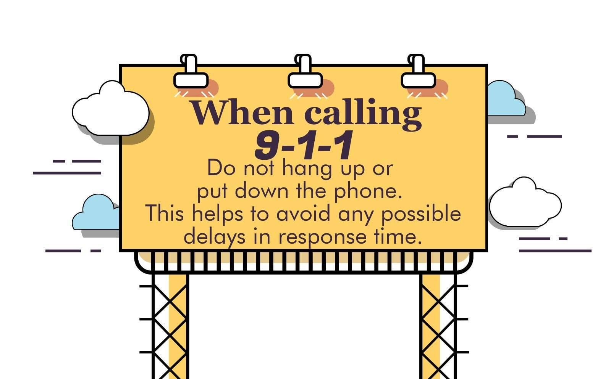
SPRING VALLEY VILLAGE POLICE DEPARTMENT
COMMUNITY MATTERS.
WE ARE A TEAM.
1025 CAMPBELL ROAD, HOUSTON, TX 77055
PHONE: 713-465-8323 / EMAIL: DISPATCH@SPRINGVALLEYTX.COM

Slide 7
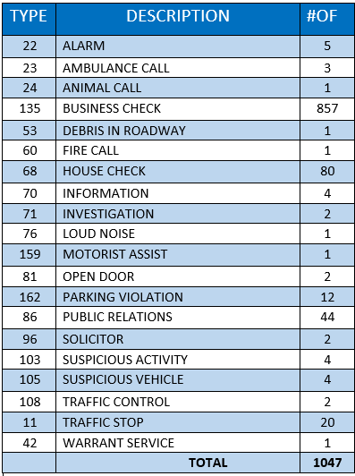
SPRING VALLEY VILLAGE POLICE DEPARTMENT
HILSHIRE VILLAGE
CALLS BY TYPE: 03-01-2025 THRU 03-31-2025
COMMUNITY MATTERS.
WE ARE A TEAM.
1025 CAMPBELL ROAD, HOUSTON, TX 77055
PHONE: 713-465-8323 / EMAIL: DISPATCH@SPRINGVALLEYTX.COM

Slide 8

SPRING VALLEY VILLAGE POLICE DEPARTMENT
COMMUNITY MATTERS.
WE ARE A TEAM.
1025 CAMPBELL ROAD, HOUSTON, TX 77055
PHONE: 713-465-8323 / EMAIL: DISPATCH@SPRINGVALLEYTX.COM

Slide 9
IMPORTANT NUMBERS AT A GLANCE
EMERGENCY |  | NON - EMERGENCY
911 - FOR ALL EMERGENCY |  | 713-465-8323
988 – NATIONAL SUICIDE & MENTAL HEALTH
SPRING VALLEY VILLAGE |  | VILLAGE FIRE DEPARTMENT
SPRING VALLEY - CITY HALL | 713-465-8308 | VILLAGE FIRE DEPARTMENT |  | 713-465-2323
SPRING VALLEY - PD | 713-465-8323 | VFD - NON-EMERGENCY |  | 713-468-7941
SPRING VALLEY - PD FAX | 713-465-3135
SPRING VALLEY - COURT | 713-465-0333
HILSHIRE VILLAGE
HILSHIRE VILLAGE – CITY HALL | 713-973-1779
COMMUNITY MATTERS.
WE ARE A TEAM.
1025 CAMPBELL ROAD, HOUSTON, TX 77055 / PHONE: 713-465-8323 / EMAIL: DISPATCH@SPRINGVALLEYTX.COM

